Slide 1
Make NLP affordable again: Model pruning for GPT-3 scale large language models
Dissertation Project
2024.9.4
Qiyao Yang

Slide 2
CONTENTS
Introduction
1
Background and significance of the selected topic
2
Experimental Design
3
Conclusion
Outline of the experimental setup
Reflections on findings and summary

Slide 3
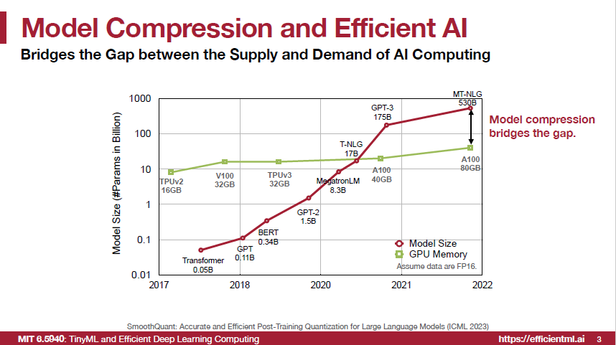
Introduction
The Rise of Large Language Models (LLMs)
Background: Large language models have transformed NLP with their impressive capabilities. As models like GPT-4 grow, their computational demands have surged.
Applications: These models are widely used in tasks such as text generation and translation, pushing the limits of current computational resources.
Challenges: The rapid growth in model size outpaces available computing power, creating a gap that model compression seeks to bridge.

Slide 4
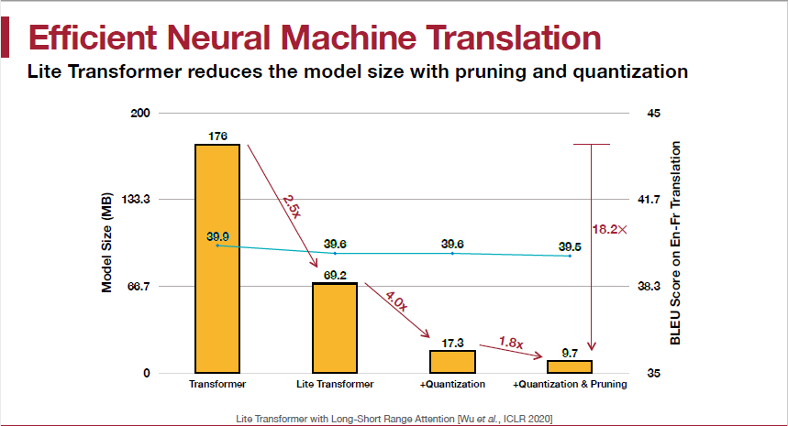
Introduction
Why Do We Need Model Compression?
Model compression reduces the size and computational demands of LLMs
Compressed models significantly reduce resource requirements with minimal performance loss.

Slide 5
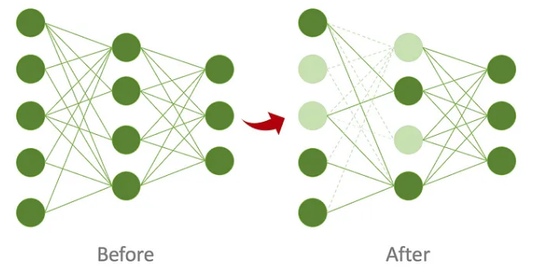
Model Compression Approaches
Definition:
Removes some weights by setting them to zero, while aiming to maintain performance as much as possible.
Quantization
Knowledge Distillation
Pruning
Neural Architecture Search

Slide 6
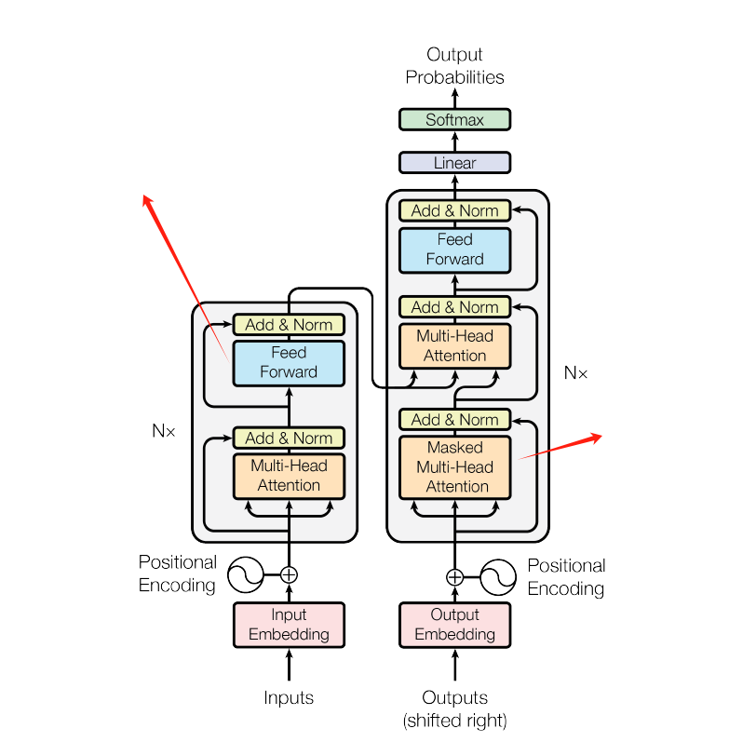
Research Motivation and Project Focus
Mainstream Research Directions
Mainstream methods include efficient pruning techniques like WANDA (Wang et al., 2023) and SparseGPT (Frantar et al., 2023), which focus on reducing model size by removing less important parameters.
MLP (Multi-Layer Perceptron) Modules
Limitations of Current Methods
Some studies suggest that different components of the model vary in importance (Ji et al., 2023; Xiao et al., 2022). However, there is a lack of targeted experiments, and common pruning methods treat the model as a whole without specific focus
Attention Modules
Project Focus
My project investigates how pruning different modules or their combinations impacts whole model performance, aiming to understand the optimal balance for effective pruning.

Slide 7

Experimental Setup
3
Combined Module
Impact on Task Performance
Performed combined pruning of all attention heads or all MLP layers to compare their collective effect on model performance.
2
Single Module
Perplexity vs Pruned Weight Numbers
Since different modules have different numbers of parameters,
the same pruning rate removes different amounts of weights.
Pruned varying amounts of weights from different modules to assess their impact on model perplexity.
1
Single Module
Perplexity vs Pruning Rate
Performed targeted pruning of different modules at various levels (e.g., 50%, 70%, 90%) to evaluate their impact on model perplexity.

Slide 8
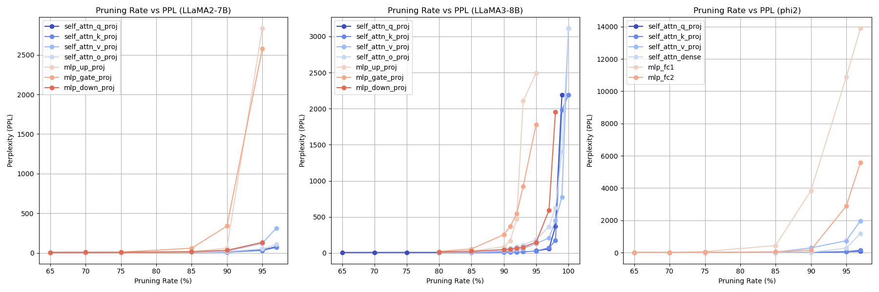
Experimental Setup
Experiments 1: Single Module-Pruning Rate
Effect of Pruning Different Modules on Model Perplexity
Single Module Pruning -PPL vs Pruning Rate : Performed targeted pruning of different modules at various levels (e.g., 50%, 70%, 90%) to evaluate their impact on model perplexity.
Orange/Red line: MLP
Blue line: Attention
At the same pruning rate, MLP modules seem to have a bigger impact on the model, but due to the different number of parameters between MLP and Attention modules, this doesn't directly prove that MLP is more important.

Slide 9
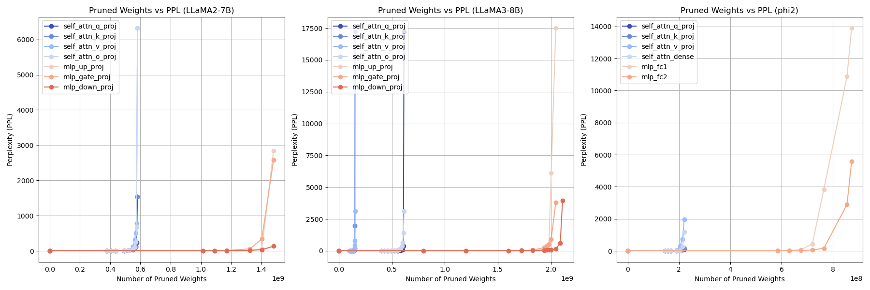
Experimental Setup
Experiments 2: Single Module - Pruned Numbers
Single Module Pruning -PPL vs Pruned Numbers : Pruned varying amounts of weights from different modules to assess their impact on model ppl.
Orange/Red line: MLP
Blue line: Attention
When pruning the same number of parameters, the impact on perplexity is significantly greater for Attention modules compared to MLP modules.

Slide 10
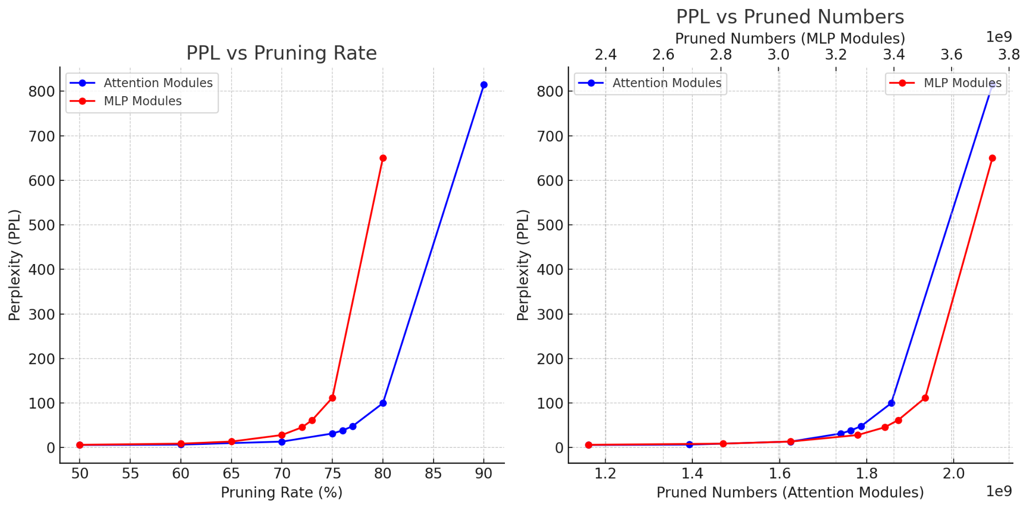
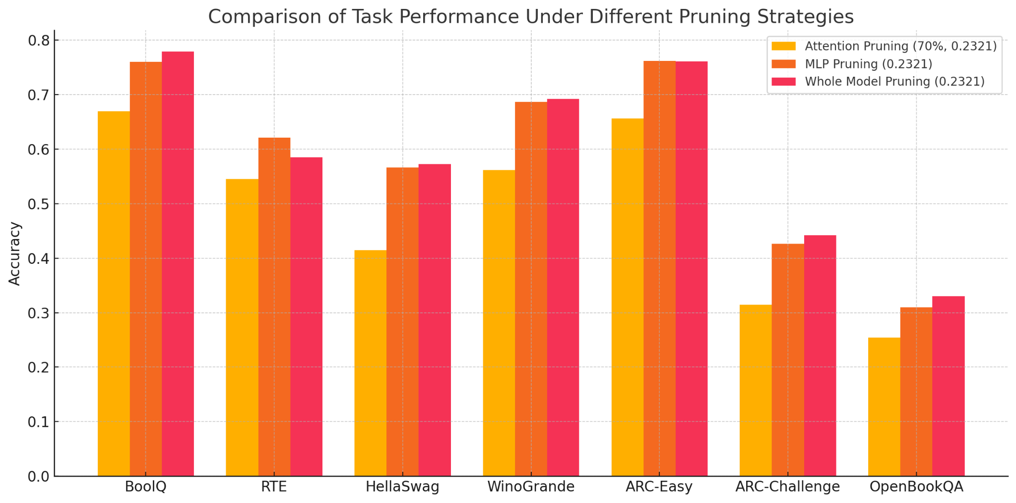

Experimental Setup
Experiments 3: Combined Module - DownStream Tasks
MLP Pruning: had higher accuracy than pruning the entire model in RTE and ARC-Challenge tasks, indicating that MLP pruning has a smaller impact on the model's reasoning ability.
Attention Pruning: Led to a significant decline in accuracy across all tasks, indicating a broad impact on overall model performance.

Slide 11
Conclusion
Summary of the Findings
Single Module Pruning Results:
Attention Pruning: Pruning attention modules led to a noticeable increase in perplexity (PPL), indicating a sensitivity to pruning.
Module Importance: Within modules, certain components like attention_v appeared more critical, heavily influencing model performance.
Downstream Task Results:
Attention Pruning: Significant accuracy decline across tasks, indicating a broad impact on overall performance.
MLP Pruning: Less detrimental to reasoning abilities, even outperforming whole model pruning in specific reasoning tasks.

Slide 12
Conclusion
Emphasis on Advantages:
This project provides new insights into the impact of single and combined module pruning on model performance.
Future Work:
Conduct more comprehensive experiments to explore the impact of different pruning combinations on various tasks and models.
Utilize stronger evaluation frameworks, such as UltraEval, to better assess the effectiveness of pruning strategies.

Slide 13
Thanks for your listening
Dissertation Project
2024.9.4
Qiyao Yang

